Slide 1
Prediction of 90-Days Mortality of Septicemia (Sepsis)
Shivadath Gannavarapu
Deep Learning (Spring 1, 2023)
Dr. Youakim Badr

Slide 2
Problem
Sepsis is the body’s extreme response to an infection. It is a life-threatening medical emergency. Sepsis happens when an infection you already have triggers a chain reaction throughout your body. Infections that lead to sepsis most often start in the lung, urinary tract, skin, or gastrointestinal tract. Without timely treatment, sepsis can rapidly lead to tissue damage, organ failure, and death.
Sepsis is a very significant disease in the intensive care units (ICUs), not to mention how burdensome it is financially. It accounts for more than $6 billion pounds in hospital expenses of UK. In 2011 the US spent over 20 billion dollars on hospital care for sepsis patients, with expense growing to over 23 billion (responsible for 6.2% of all US hospital costs).
Early identification of high-risk sepsis patients can lead to earlier intervention and more targeted treatment, which can improve patient outcomes and reduce mortality rates.
By predicting the 90-day mortality of sepsis patients in the ICU, healthcare providers can identify patients who are at a high risk of dying. This can help them prioritize care and allocate resources more effectively.
Some of machine learning models to develop decision support systems for the ICU that can provide real-time feedback to clinicians on dynamic changes in a patient's medical condition. There are some limitations of severity score systems in predicting hospital mortality based on baseline patient characteristics, as these evaluations take a long time and may not provide real-time feedback.

Slide 3
Context and Introduction
Sepsis is a life-threatening condition that occurs when the body's immune response to an infection causes damage to its own tissues and organs. Despite advances in medical care, sepsis remains a leading cause of morbidity and mortality worldwide. Mortality rates associated with sepsis can be as high as 30%, and even higher for patients who require treatment in the intensive care unit (ICU).
Early identification and treatment of sepsis is critical for improving patient outcomes and reducing mortality rates. Various methods have been developed to predict the risk of mortality in sepsis patients, such as severity score systems and analytics on electronic health records (EHRs) data. However, these methods have limitations, including the time required to evaluate and provide results.
The objective of sepsis mortality prediction is to identify patients who are at a high risk of dying from sepsis and provide early intervention to improve their chances of survival. This can involve analyzing various patient data, such as vital signs, laboratory values, and clinical notes by developing a Deep Learning algorithm using Convolution Neural Networks and Recurrent Neural Networks that detects the severity of Sepsis based on patient’s ICU readings as a input.
Deep learning algorithms can analyze large amounts of patient data, such as vital signs, laboratory values, and clinical notes, to identify patterns and predict patient outcomes. These algorithms can also be trained on diverse patient populations and can adapt to new data over time, improving their accuracy and reliability.

Slide 4
Data Collecting
To identify the severity of the sepsis that leads to the mortality we have used Medical Information Mart for Intensive Care (MIMIC-III) dataset.
The MIMIC-III (Medical Information Mart for Intensive Care III) database is a large, publicly available critical care database that contains de-identified data from over 50,000 intensive care unit (ICU) admissions at the Beth Israel Deaconess Medical Center between 2001 and 2012.
To perform sepsis mortality prediction using the MIMIC-III database, we extracted the relevant patient data from the database, including demographic information, vital signs, laboratory values, and clinical notes.
The MIMIC-III dataset contains 35 comma-separated files. For our purposes, we will be focusing on six specific tables within this dataset. These below mentioned tables will provide the necessary data to address our specific problem.
Patients.csv
Admissions.csv
ICUStays.csv
Diagnoses.csv
D-Labstays.csv
Labevents.csv

Slide 5
Data Preprocessing
The data has been split into several files, with each file containing a table that includes a foreign key linking it to another table.
After analyzing the dataset, we have identified and removed the columns that are not necessary for solving the problem at hand. This helps to reduce the complexity of the dataset and improve the accuracy of deep learning models that use the remaining columns.
We are working with an admissions dataset that includes the date of birth and admission date of each patient. We have developed a function that calculates the age of the patient based on these two dates, specifically using the admission date and date of birth as inputs.
A function was also created to compute the occurrence of death within 90, 60, and 30 days.
After conducting an analysis of all the necessary files, we utilized the pandas merge() function to consolidate the data from multiple CSV files into a single table.
The tables were joined using an inner join, which ensured that only the matching records from both tables with respect to the columns such as SUBJECT_ID, HADM_ID, and ITEMID were retained.
After joining all the tables we have got a final dataset of shape (8182130,20).
In the given code, the groupby function has been applied to the ITEMID column in a dataset to count the frequency of each lab test taken.

Slide 6
Data Preprocessing
We chose to consider lab tests with an ITEMID count greater than 700 because a higher ITEMID count indicates that the test is more important. Since the maximum ITEMID count in our dataset was 2728, we opted for a count greater than 700 for practical reasons, to make the analysis feasible on our system.
Again, we have created two copies of datasets to perform some transformations.
The first dataset was transformed using pandas pivot table to reshape the data so that each unique lab test name was assigned as a column name, while the corresponding numerical test result values from the VALUENUM column were assigned to the appropriate column for each SUBJECT_ID. This allowed for easy comparison of test results between subjects and simplified further analysis of the data.
Here, we have explored the new dataset and we encountered many missing values, as many of the lab readings haven’t recorded.
We have generated a new DataFrame by filling in the missing values in the original dataset. Then, we have filtered this new DataFrame to create a list of columns that contain more than 100 null values.
The code used the SimpleImputer class from the scikit-learn library to fill all the missing values in a dataset with the mean value. This imputation strategy was specified as 'mean’.
Now, we have performed the exploratory data analysis on this dataset and plotted the outliers using box-plots.
It has been observed that numerous numerical columns in the dataset contain outliers, which may cause the deep learning model to function less efficiently.

Slide 7
Data Preprocessing
To address the issue of outliers in the dataset, the code uses a statistical technique called Winsorizing, which is implemented through a function from the Scipy.stats library. Winsorizing involves substituting extreme values in the dataset with less extreme values to minimize their impact on the analysis.
We have created a histogram for each numerical column, and although they do not follow a normal distribution, their distribution patterns have been visualized.
We evaluated the skewness of each numerical column and applied standard scaling to the data using the StandardScaler module in the scikit-learn library. The purpose of this process is to normalize the data and make it suitable for deep learning algorithms that are sensitive to the scale of the features.
We used the variance inflation factor to detect the degree of collinearity between the features, as this can potentially affect the model's ability to identify patterns in the data. By identifying and removing highly correlated features, we aim to improve the performance and accuracy of our deep learning models.
we have computed the 75th percentile of the variance inflation factor for a dataset and removed the columns that have a variance inflation factor greater than this value. This process is used to filter out highly correlated features that may negatively impact the performance of deep learning models that rely on these features.
Created a new variable to store the numerical columns of a dataset and then used the variance_inflation_factor() function to calculate the VIF values for each feature. This helps to identify any potential issues with multicollinearity among the features.

Slide 8
Data Preprocessing
Kurtosis is a statistical measure that describes the shape of a probability distribution, such as a frequency distribution of a dataset. It measures the degree to which the tails of a distribution differ from the tails of a normal distribution, which is a distribution with a kurtosis value of 0.
We have calculated the kurtosis values of the each numerical variable and every value is in negative. a negative kurtosis value indicates that a distribution has lighter tails than a normal distribution, meaning that it has fewer extreme values. This type of distribution is said to be platykurtic.
Now we have performed the correlation matrix and plotted the heatmap using seaborn library to see the correlation between the features.
we have set a correlation threshold of 0.5 and created an empty list to store correlated features. We have then calculated the correlation matrix of some dataset and converted it to absolute values. We have then iterated through the correlation matrix and compared each pair of features to see if their absolute correlation value is greater than the threshold. If it is, we have appended a tuple of the correlated feature names to the list of correlated features. Finally, we have printed the list of correlated features. This code is useful for identifying pairs of features that are highly correlated, which can be a problem for some machine learning algorithms.
Removed the columns having more than 0.5 to reduce the multicollinearity between highly correlated features, which can improve the performance of deep learning models that rely on these features.

Slide 9
Methodology
Methodology:
Data Collection: The first step in our project was to collect data on patients with septicemia. We used MIMIC- III to obtain data on patient demographics, medical history, and clinical variables.
Data Preprocessing: The collected data was then preprocessed to remove any irrelevant variables, handle missing data, and convert categorical variables into numerical ones.
Model Selection: We used GRU, LSTM, and Conv1D architectures for predicting the 90,60 and 30-day mortality of patients with septicemia. We trained and tested all three models and plotted their performance to determine the best-performing model.
Model Evaluation: After selecting the best-performing model, we evaluated its performance using standard evaluation metrics such as accuracy, precision, recall, and F1 score. We also used various visualizations like ROC-AUC curves to understand the model's performance better.
Model Optimization: We fine-tuned the selected model to improve its performance further. We tried various hyperparameters such as learning rate, batch size, and epochs to achieve the best possible performance.
Final Model Selection: After evaluating and optimizing the models, we selected the Conv1D architecture as our final model, which achieved an accuracy of 98% in predicting the 90-day mortality of patients with septicemia.

Slide 10
Models Architecture
GRU (Gated Recurrent Unit) is a type of recurrent neural network (RNN) widely used in deep learning classification problem.
Model with one layer having 32 units with dropout rate of 0.2 and dense layer.
Total Params : 3,993
LSTM (Long Short-Term Memory) is a type of recurrent neural network (RNN) architecture that is commonly used for sequence modeling tasks.
Model with two layers with 64 and 32 units respectively with dropout rate of 0.2 and dense layer.
Total Params: 29,345
Conv1D (Convolution 1D) is a neural network architecture that is specifically designed for processing one dimensional data.
Model with two layers with 32 and 64 filters with kernel_size as 3 and activation as ‘Relu’
Adding max pooling layer with pool_size=2
Adding batch Normalization and Dropout layers respectively to prevent overfitting.
Adding flatten and dense layers at the end.
Total Params : 97,089

Slide 11
Model Hyperparameters
 | GRU | LSTM | CNN built
Optimizer | Adam | Adam | Adam
Loss Function | Binary_crossentropy | Binary_crossentropy | Binary_crossentropy
Batch Size | 64 | 64 | 64
CallBacks | Early Stop | Early Stop | Early Stop
Performance Metric | Accuracy | Accuracy | Accuracy

Slide 12
Evaluations – Performance For Best Models after Tuning
Training | Accuracy | Precision | Recall | F1-Score
GRU | 0.9877926978137832 | 0.9893783542039356 | 0.9860708714062848 | 0.9877218439557985
LSTM | 0.9864609921207413 | 0.9809387395328338 | 0.9920882549587697 | 0.9864819944598338
CNN model | 0.9931750083231606 | 0.9919955530850473 | 0.9943169155337642 | 0.9931548778451778
Validation | Accuracy | Precision | Recall | F1-Score
GRU | 0.9707405489383739 | 0.9700598802395209 | 0.9734601902854282 | 0.9717570607348163
LSTM | 0.9642672190574831 | 0.9545232273838631 | 0.9774661992989484 | 0.9658584858980702
CNN model | 0.9803210771620922 | 0.9776230730979613 | 0.9844767150726089 | 0.9810379241516967
Testing | Accuracy | Precision | Recall | F1-Score
GRU | 0.9764370792335577 | 0.9753280839895013 | 0.9768664563617245 | 0.9760966640399265
LSTM | 0.9733298808907301 | 0.9610456176319836 | 0.9858044164037855 | 0.9732675837010122
CNN model | 0.9873122734334542 | 0.9858416360776088 | 0.9884332281808622 | 0.987135731163035

Slide 13
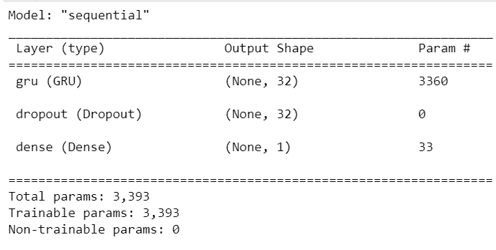
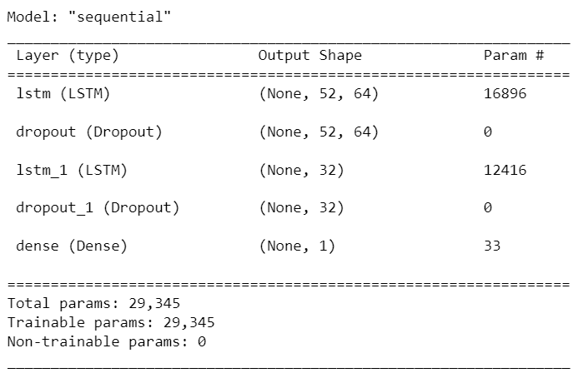
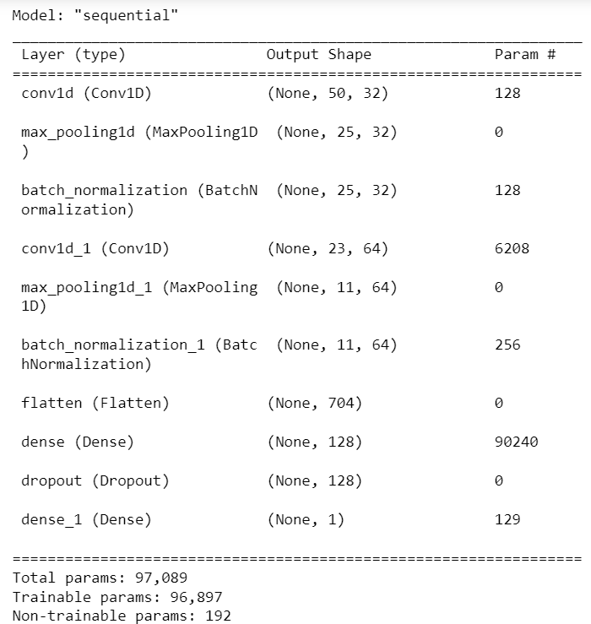
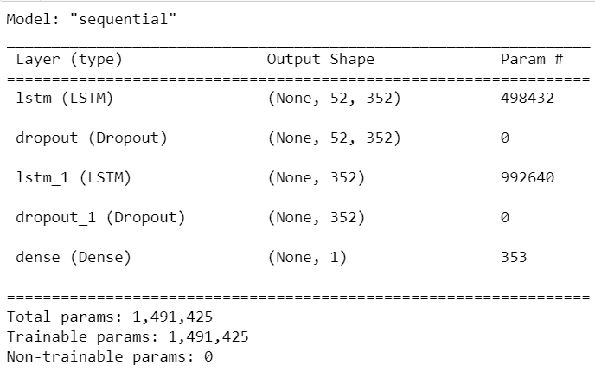
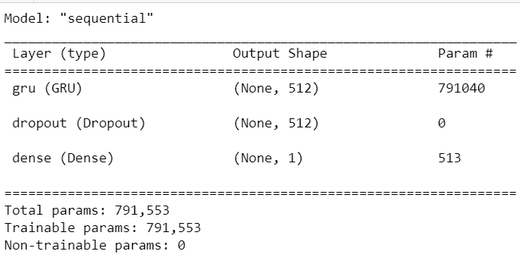
Model Summary
GRU
LSTM
CNN
Base Model
Base Model
Base Model
Best Model achieved by Tuning
Best Model achieved by Tuning
Best Model achieved by Tuning
The model already achieved
98% accuracy so no tuning
is not required.

Slide 14
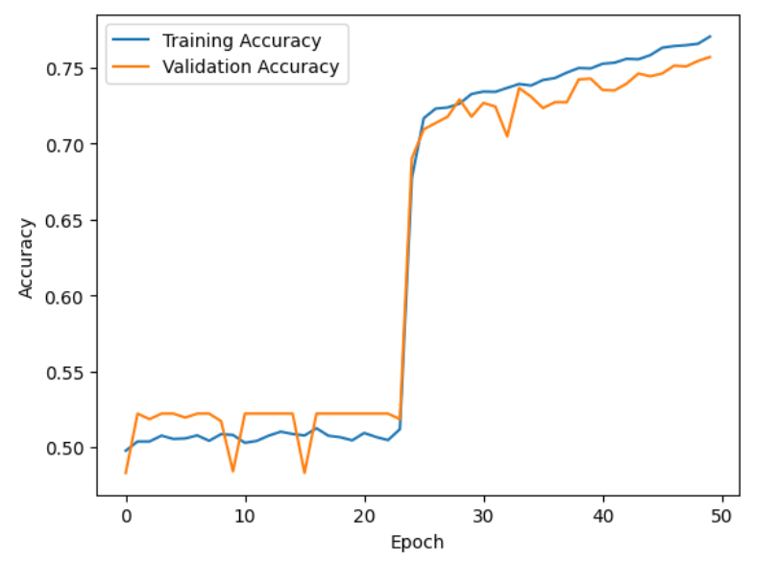
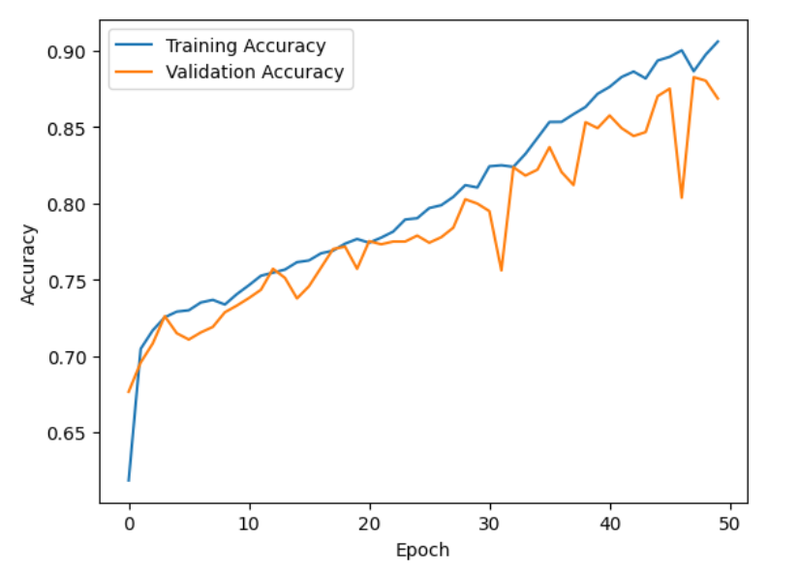
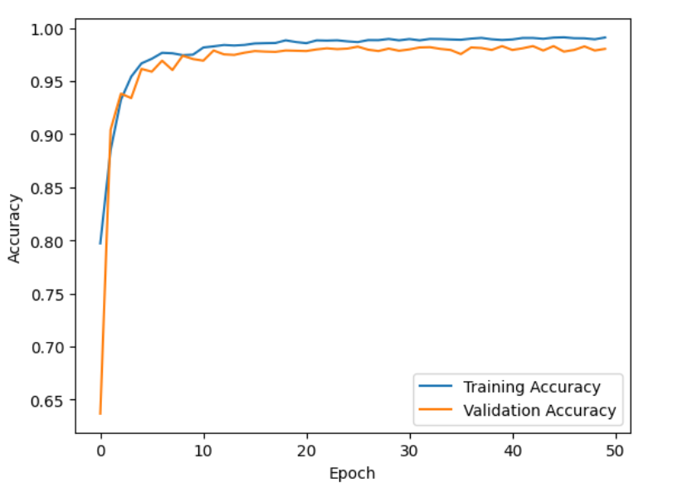
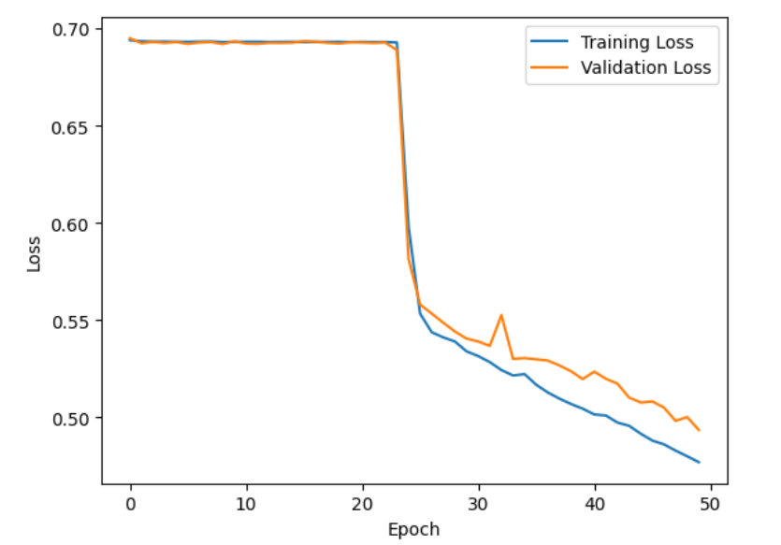
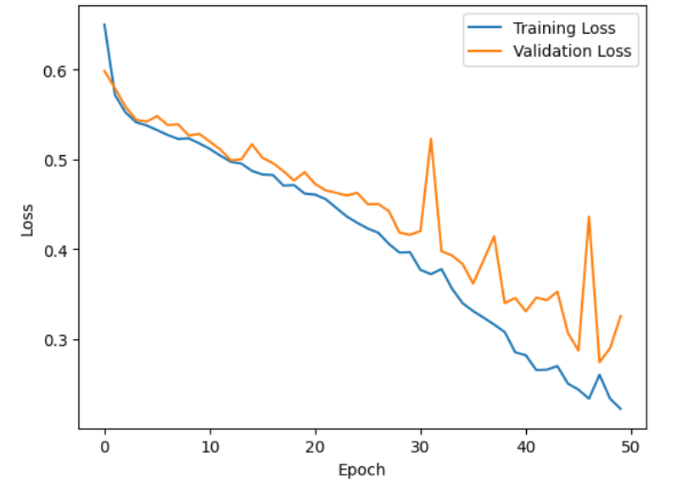
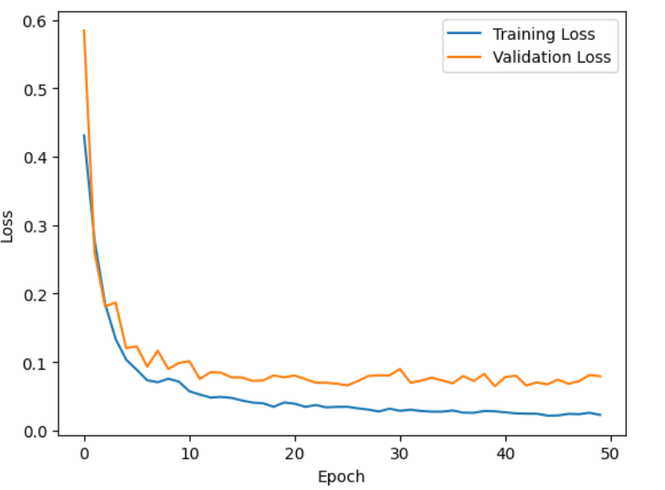
Accuracy and Loss Plots
GRU
LSTM
CNN
Accuracy Graph
Accuracy Graph
Accuracy Graph
Loss Graph
Loss Graph
Loss Graph

Slide 15
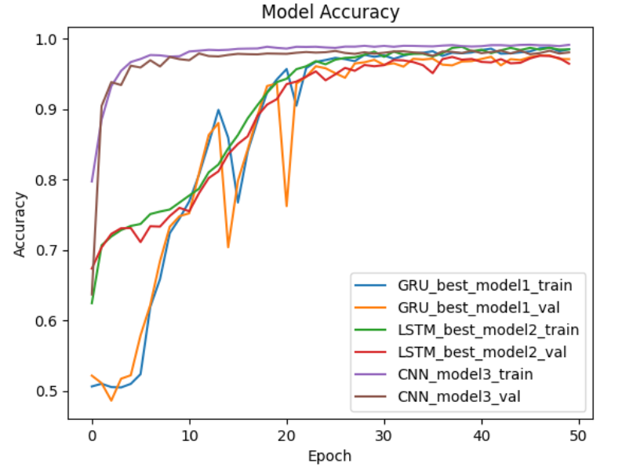
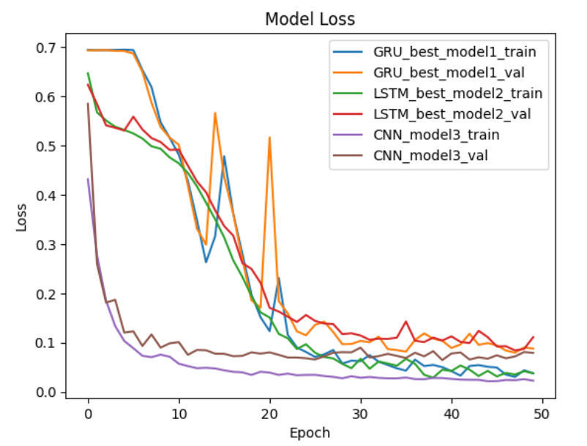
Accuracy and Loss plots for all three best models after tuning

Slide 16
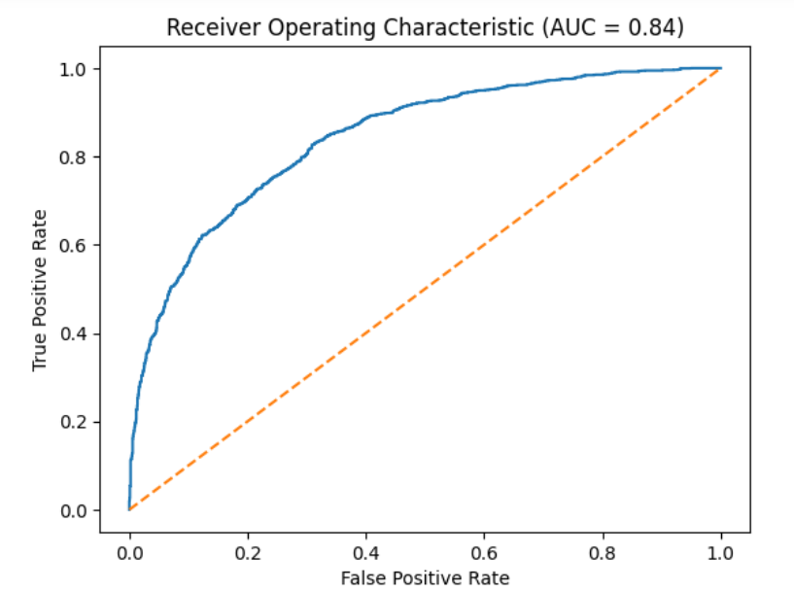
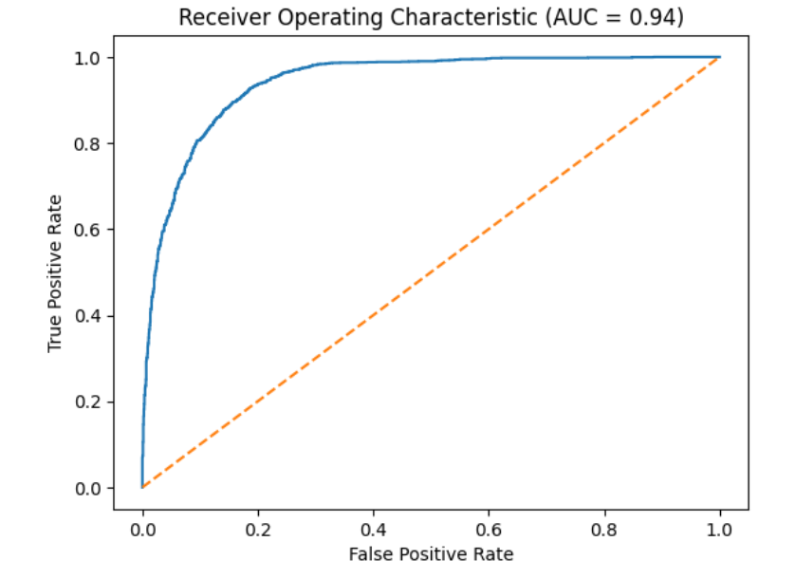
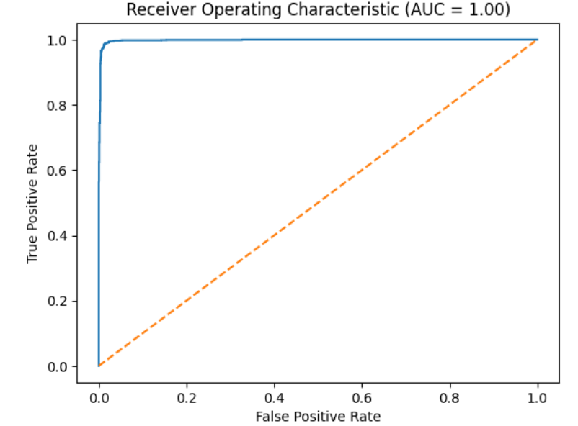
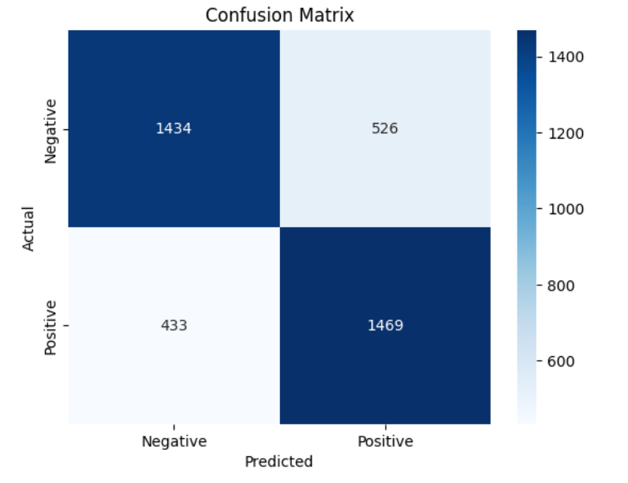
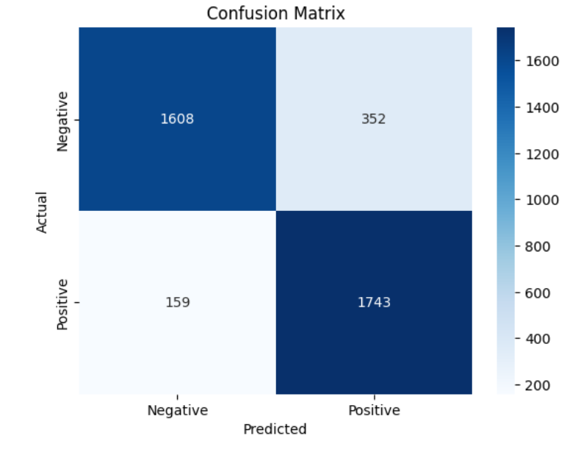
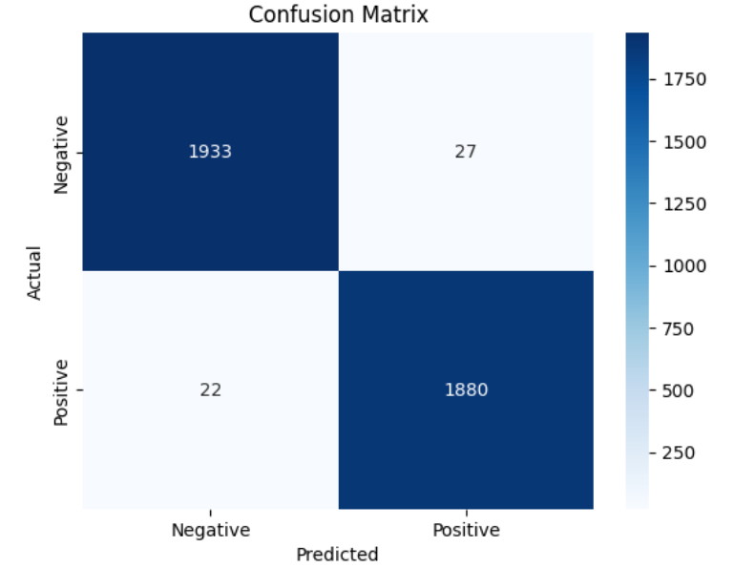
Model Evaluation using confusion matrix and ROC-AUC Curve
GRU
LSTM
CNN-Build
ROC Graph
ROC Graph
ROC Graph

Slide 17
Lessons learned and Perspectives
Deep learning models require large amounts of high-quality data to perform well. In the case of mortality prediction, this means having access to accurate and comprehensive medical records for a significant number of patients.
Preprocessing is one of the key factor while building deep learning models as biased or incorrect data can change the way model learns
Feature engineering is important: Choosing the right set of features for a deep learning model can be a time-consuming and iterative process. It is important to consider not only clinical data, but also demographic and other relevant factors that may impact mortality risk.

Slide 18
Bibliographical References
28‐day sepsis mortality prediction model from combined serial interleukin‐6, lactate, and procalcitonin measurements: a retrospective cohort study
https://link.springer.com/article/10.1007/s10096-022-04517-1
Predicting in-hospital mortality in ICU patients with sepsis using gradient boosting decision tree. https://link.springer.com/article/10.1007/s10096-022-04517-1

Slide 19
Demo !

